Slide 1

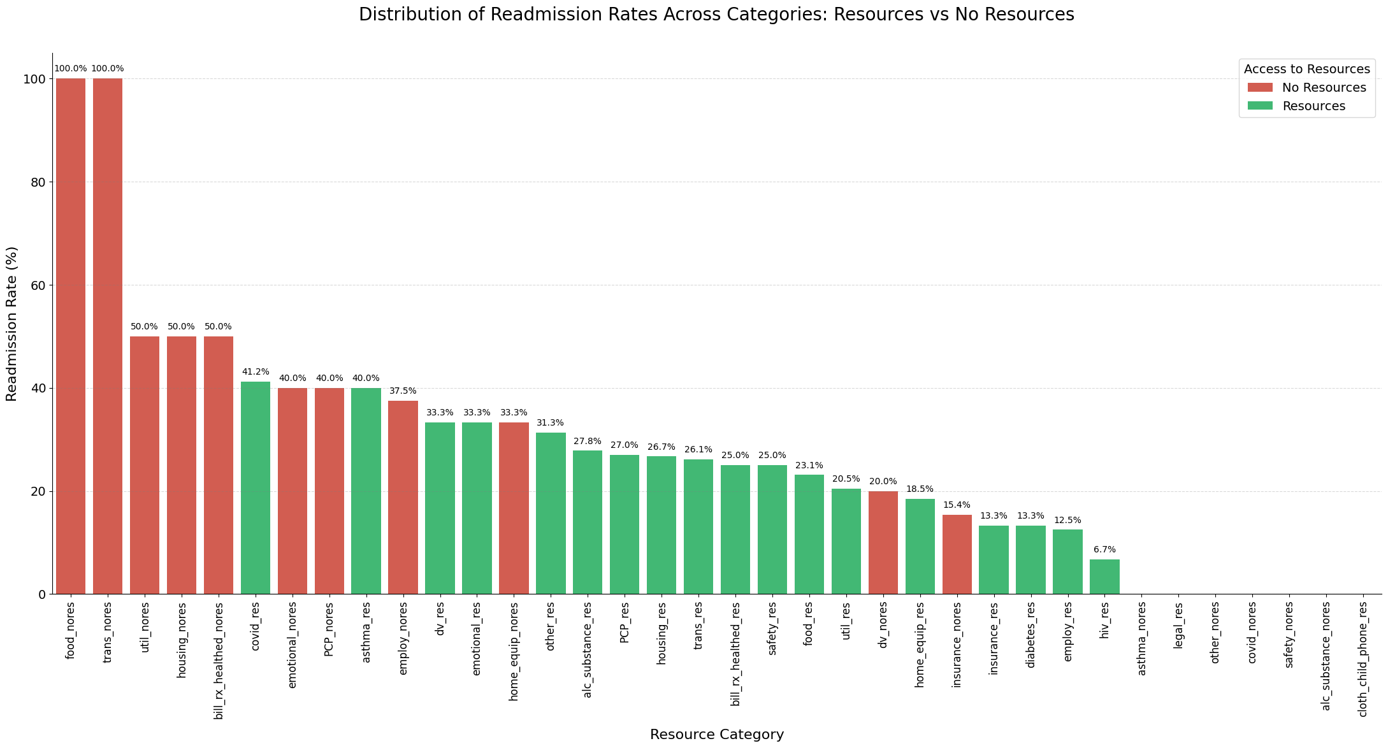
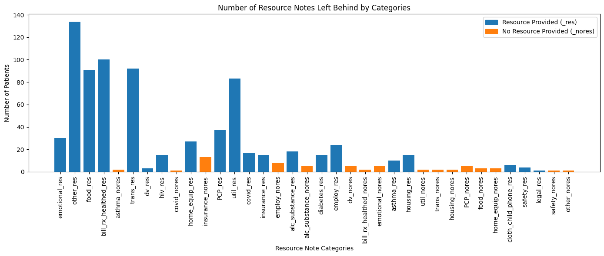
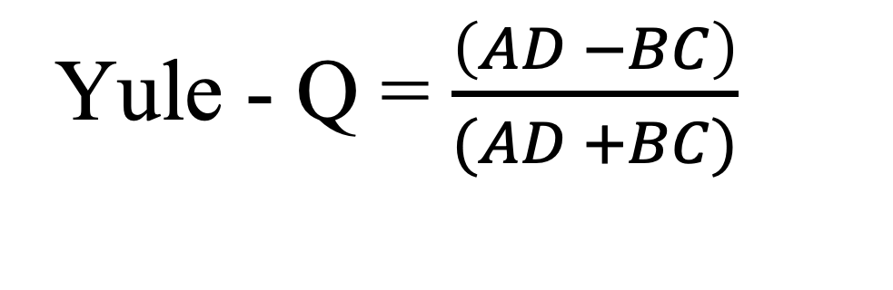
Leveraging Community Health Worker (CHW) Notes to Supplement Tabular Features and Improve the Classification of Emergency Department (ED) Readmissions.
mnguye93@depaul.edu
amishr15@depaul.edu
nmaglani@depaul.edu
CPATEL54@depaul.edu
draicu@cdm,.depaul.edu
Kelly.McCabe@sinai.org
jfurst@cdm.depaul.edu
rtchoua@depaul.edu
Minh Nguyen, Ankita Mishra, Navika Maglani, Charmi Patel, Daniela Raicu, Kelly McCabe, Jacob Furst, and Roselyne Tchoua
DePaul University, College of Computing and Digital Media
Sinai Urban Health Institute
Abstract
Results & Future Work
This work has been partially supported by the Motorola Scholars Program
As machine learning advances, researchers and healthcare providers are applying it to health informatics to improve outcomes and promote equity. The Centers for Medicare and Medicaid Services view 30-day Emergency Department (ED) readmissions as a key quality measure, aiming to reduce readmission rates. The Sinai Urban Health Institute (SUHI) trains Community Health Workers (CHWs) from local Chicago neighborhoods to support patients after discharge, helping prevent readmissions. While CHW and Social Determinants of Health (SDoH) data have been used in predictive models, CHW text notes remain untapped due to their unstructured nature. Our project focuses on a subset of “resource notes” (e.g., food, transportation) to enrich CHW notes with tags that may improve readmission predictions. So far, we’ve conducted frequency analysis and visualizations, highlighting differences between contact and resource notes, particularly around food and transportation. Preliminary results indicate a potential association between resource needs and readmission rates, supported by Yule’s Q analysis.
441 out of 2177 patients had resource notes available from community health workers (CHWs)
We explored readmission rates across resource notes categories that indicate patients readmission status
Future Work
Since there is lacking data, synthetic data will be created to see how many notes need to have to see changes on Yule – Q value
Identification of SDoH categories in unstructured contact notes by training Doc2Vec and Support Vector Machine (SVM) models on labeled resource notes data
Investigate the impact of including contact notes along with tabular data to reduce hospital readmission rates
Most patients (100 with food and 92 with transport needs) have a food or transportation need indicated in the resource notes
However, when they were not provided with food or transportation resources, they had the highest readmission rates
The provision of SDoH-needed resources drastically reduces readmission rates in patients.
Background
Patients without food resource notes were all readmitted
Patients with food resource notes had a much lower readmission rate (21 out of 91 = ~23%)
The negative Yule’s Q of -1.0 means that the presence of food resource notes is strongly and perfectly negatively associated with readmission in this dataset, suggesting that those with food resource support were less likely to be readmitted
Food insecurity is a key factor in hospital readmissions. Through the Hospital Readmission Reduction Program, hospitals are incentivized to address this issue with interventions like healthy food prescriptions and medically tailored meals. Sinai Urban Health Institute and DePaul University are using community health worker (CHW) data to identify high-risk patients. Our research applies machine learning to CHW resource notes to improve readmission predictions, with early results showing a link between unmet resource needs and higher readmission risk.
Methodology
Yule – Q = -1.0 | Readmitted | Not Readmitted
Food_res | 21 (a) | 70 (b)
Food_nores | 3 (c) | 0 (d)
Notes in the form of categorical variables are transformed into binary to indicate whether patients need any type of SDoH resources. Yule Q is then applied to find the correlation between resource notes and the patient's readmission status.
Yule – Q = -1.0 | Readmitted | Not Readmitted
Food_res | A | B
Food_nores | C | D
A = Readmitted Patients with Food Resource Notes
B = Non-Readmitted Patients with Food Resource Notes
C = Readmitted Patients without Food Resource Notes
D = Non-Readmitted Patients without Food Resource Notes
Acknowledgment
We would like to acknowledge the support of the following funding:
Motorola Solutions Foundation Scholar Programs
Sinai Urban Health Institute

